Slide 1
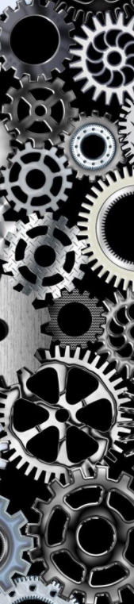
A Motorised Screw Jack Lift for Industrial Setting
A Novel Solution
Shreyansh Singh MDM18B046
Soorya Sriram MDM18B049
Y.V.R Satyam MDM18B057
Mogulla Venkata Sai MDM18B059
Khirupasagar R MDM18B063

Slide 2


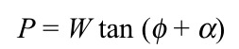
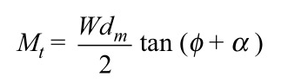
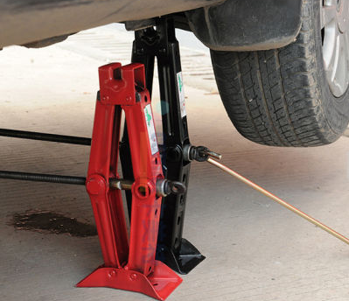
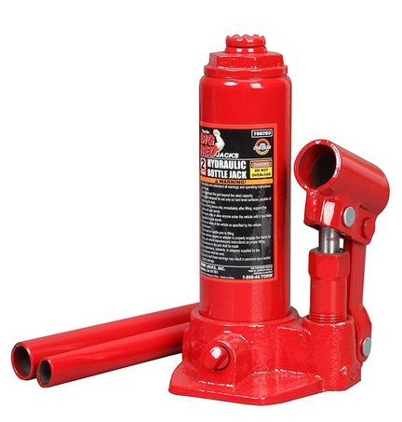
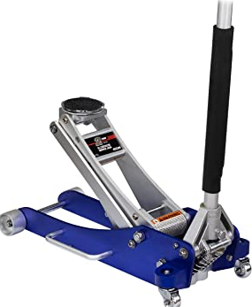
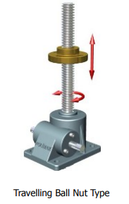
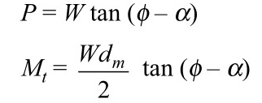
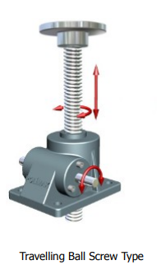
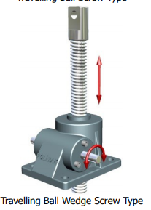
Screw jack:
A screw jack is an example of a power screw in which a small force applied in a horizontal plane is used to raise or lower a large load.
Mechanical
Types
Hydraulic
Scissor jacks
Bottle (cylindrical) Jacks
Travelling Ball Screw Type
Travelling Ball Wedge Screw Type
bottle jack
floor jack
Travelling Ball Nut Type

Slide 3
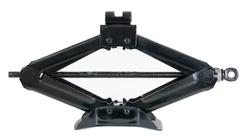
Disadvantages
Operational Constraints
Chances of dropping of the load
Tipping or slipping of the load.
Cowering position is needed to operate the design , this results in inefficiency at the workplace due to ergonomically imbalance positions which leads to
Backache
Poor body structure in the long term
Maintain low surface speed:
Keep the mating surfaces well lubricated
Keep the mating surfaces clean:
Keep heat away:
Maintain low surface contact pressure:
higher unit pressure and surface speed results in rapid wear

Slide 4
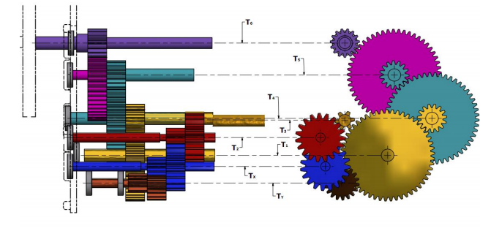
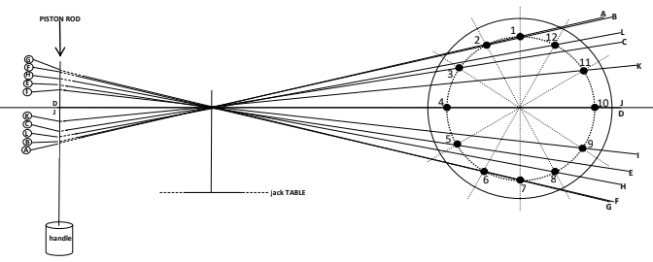
Modified Screw Jack for Lifting: Research paper 1
The modified screw jack here exploits the use of quick return crank mechanism in the process of bevel gear movement as it seems to be more efficient than the conventional type screw jacks whilst the user has ease in operating it.
During usage, the screw jack is assembled for operation extended properly. The
jack is then placed perfectly under the vehicle loading platform serving as a base for support.
The research paper suggests this Quick-return crank mechanism showing crank disc pinion positions along its path profile and relative to crank beam positions and piston rod attachment point path profile.

Slide 5
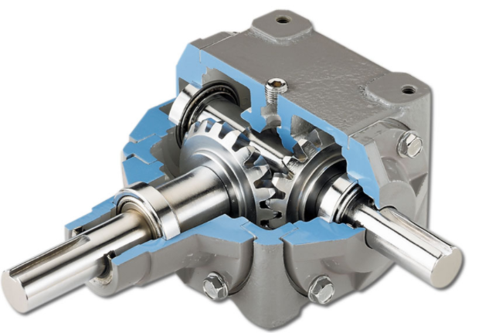
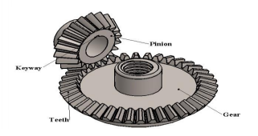
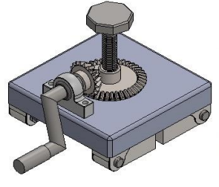
Design Analysis:
Parts Used
Power screw
Bevel gear
Crank Handle
Bearings
Jack frame
Stand
Bracket
Bolt and Nut
Advantages
The proposed mechanism is capable of increasing capacity
Reducing input effort
The time required to lift using the modified method is lesser
Ease of use for the user

Slide 6
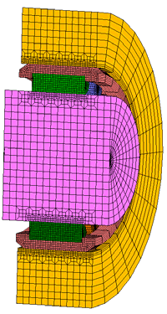
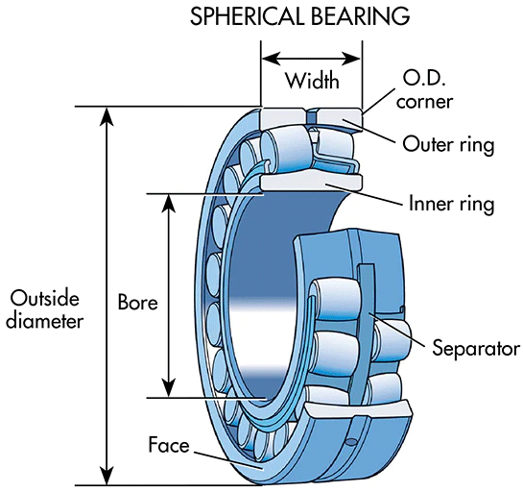
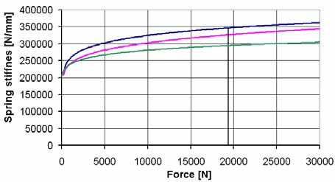
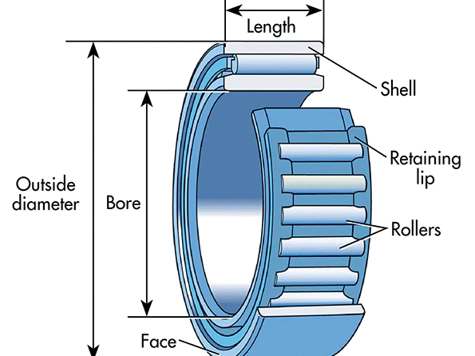
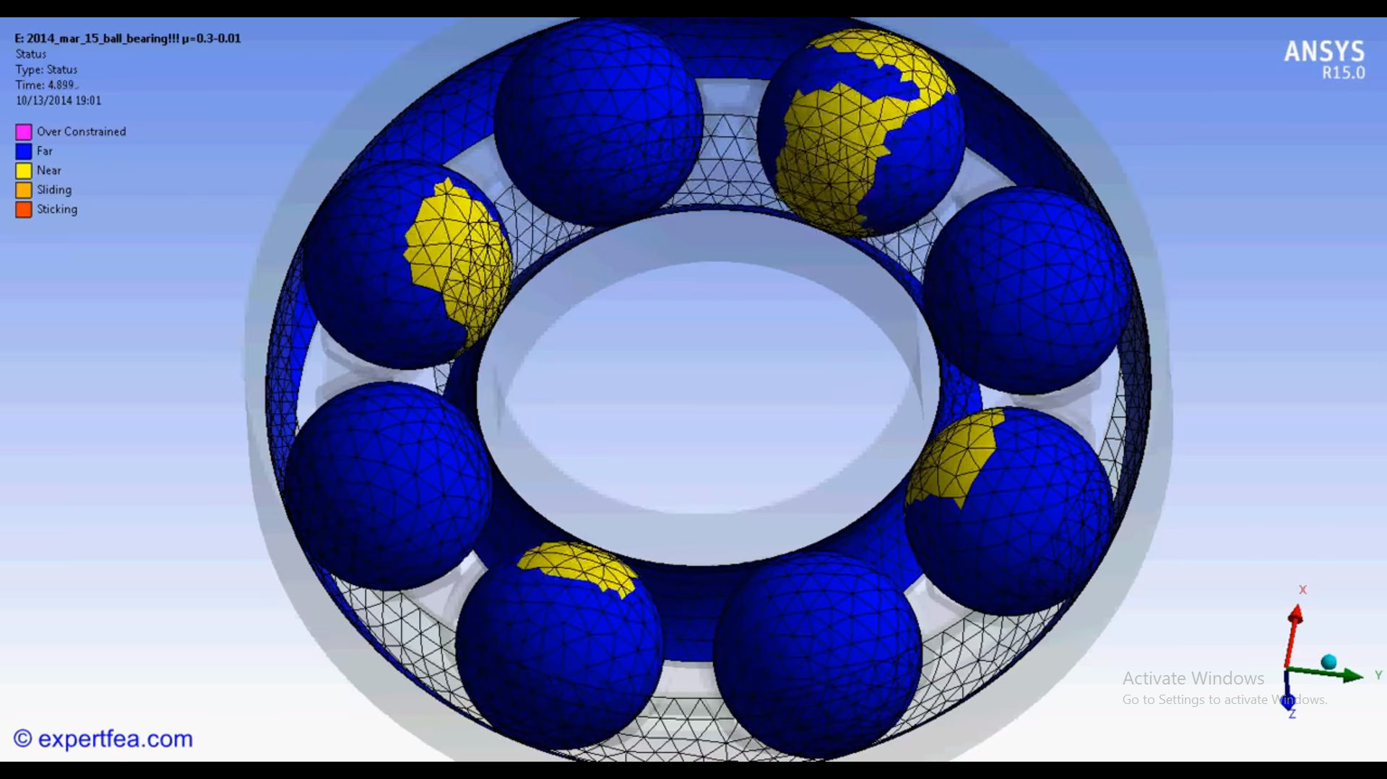
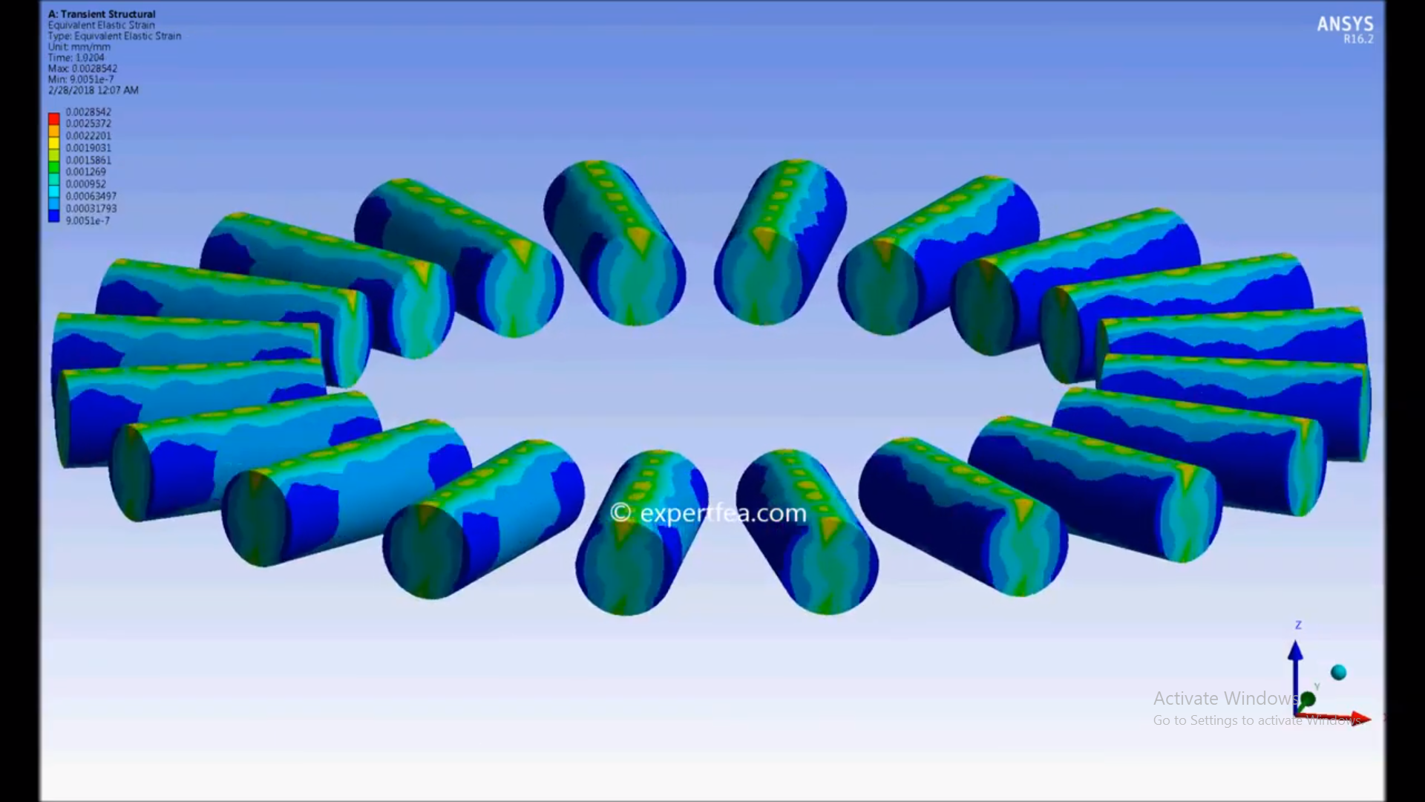
Spherical Roller Bearings
Quill Bearings
IMPROVEMENTS W.R.T to PAPER 1 Design
Advantage
3-4 Times Greater Friction
Greater Contact Surface area
Supports Greater load

Slide 7
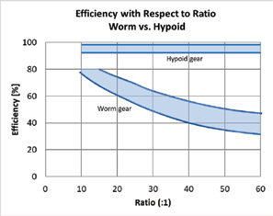
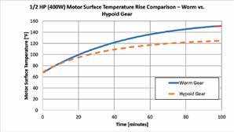
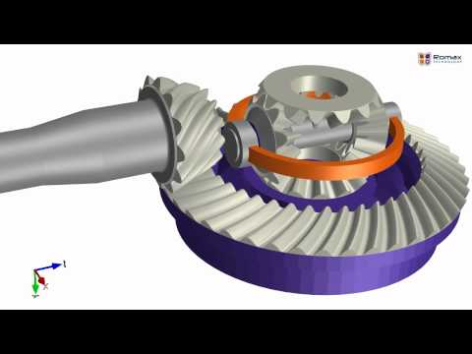
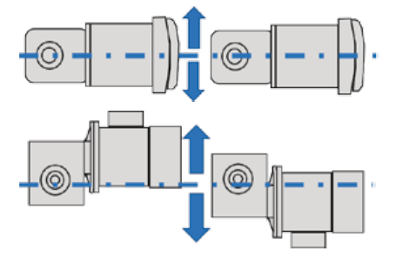
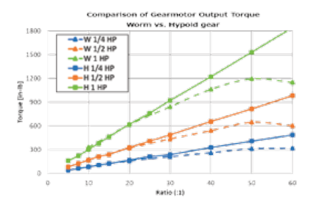
Hypoid Gears > Worm Gears
Comparative Advantage
1) Hypoid gear sets are typically 95% to 99% efficient
2) Smaller motors can be used in hypoid gear motors
3) Symmetrical
4) Hypoid reducers can move loads from a dead stop with more ease
5) Transfer more torque
A Hypoid gear is a spherical bevel gear with helical teeth. The main application of this is in a vehicle differential, where the direction of drive from the drive shaft must be turned 90 degrees to drive the wheels

Slide 8
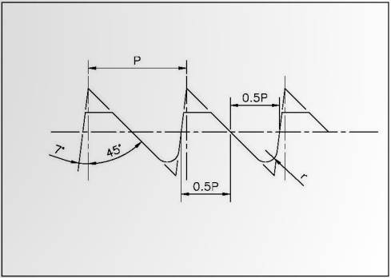
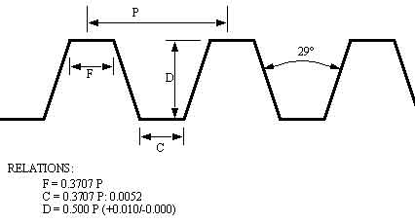
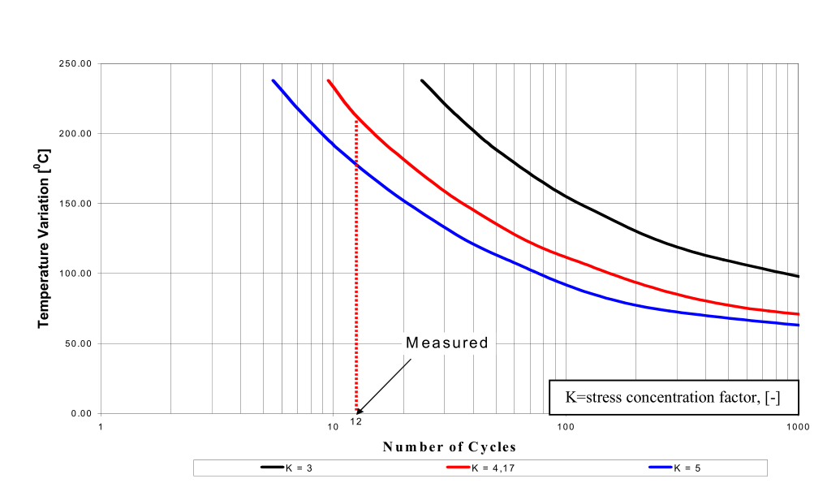
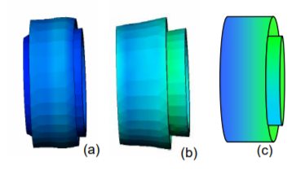
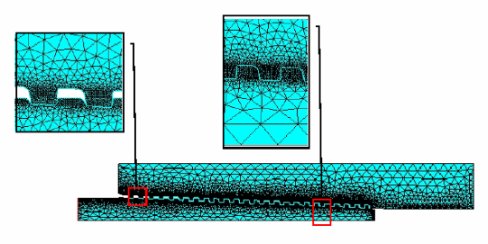
BUTTRESS THREADS
ACME THREADS
Power Screw Threads
The Acme thread form has a 29° thread angle with a thread height half of the pitch.
Advantages
Designed for high axial thrust.
Low friction properties
Twice the shear strength.
Handle high unidirectional loads with relatively low applied torque.
This is typically a 7° angle on the weight bearing surface and a 45°angle on the trailing flank, which provides a form with good shear strength.

Slide 9
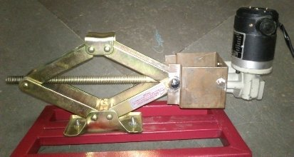
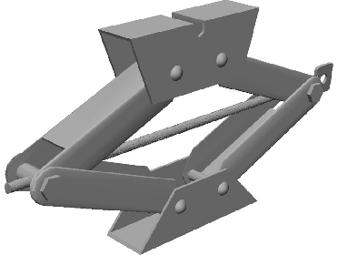
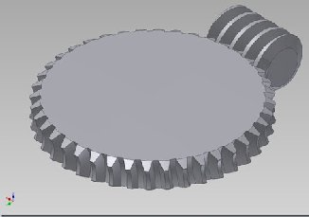
Motorised Screw Jack is aimed at reducing the effort as well as the time taken to lift the load in comparison to the ordinary screw jack.
When a high pulse is given to the motor, the motor rotates in a clockwise direction and when a low pulse is given it rotates in an anticlockwise direction. Thus the worm gear rotates and enables the lead screw to rotate in both directions.
DESIGN CALCULATIONS:
Design of screw jack
Torque required operating the screw
Power of the motors required
Material Selection
Experimental Investigation on Motorised Screw Jack - Paper 2
Advantages
It possesses a self-locking property
No radial thrust acts since the square thread is used
A higher range of speed control is obtained.

Slide 10
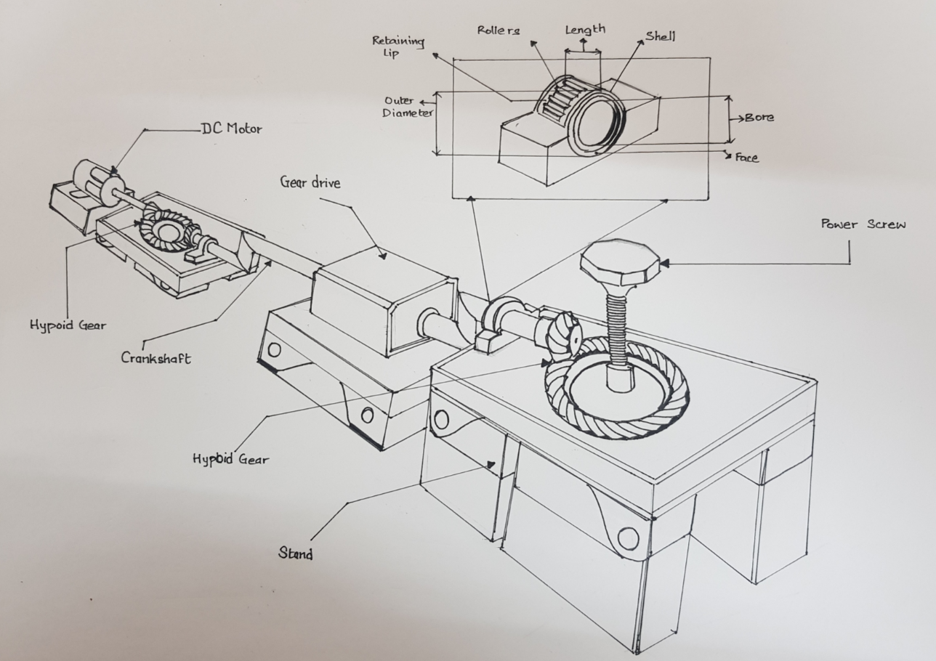
Proposed Model
Proposed Solution
Manual Screw Jack is changed to a Motorized one with addition of DC Motor with HYPLOID GEAR to transmit power.
Type of bearings is changed to Quill/Needle Bearings to increase the load carrying capacity in both radial and axial directions.
Possesses Self Locking Property
The shear strength of the Power screw is improved by using Buttress thread over ACME and Square Thread
Use of Gear Drive to improve the power and torque transmission
Thank You

